Slide 3
Applied Data Science Capstone: Presentation
Ruozhou hua
For IBM Data Science Course

Slide 4
1. Introduction:
This Capstone Project aim to create an analysis of features for a people migrating to Scarborough to search a best neighborhood as a comparative analysis between neighborhoods. The features include median housing price and better school according to ratings, crime rates of that particular area, road connectivity, weather conditions, good management for emergency, water resources both freash and waste water and excrement conveyed in sewers and recreational facilities.

Slide 5
2. Data Section
Data Link: https://en.wikipedia.org/wiki/List_of_postal_codes_of_Canada:_M
Will use Scarborough dataset which we scrapped from wikipedia on Week 3. Dataset consisting of latitude and longitude, zip codes.

Slide 6
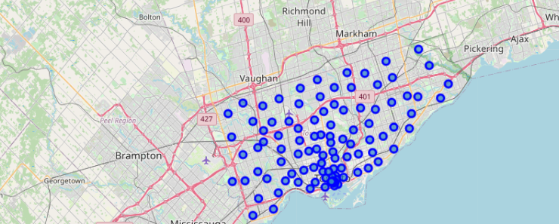
Map of Scarborough

Slide 7
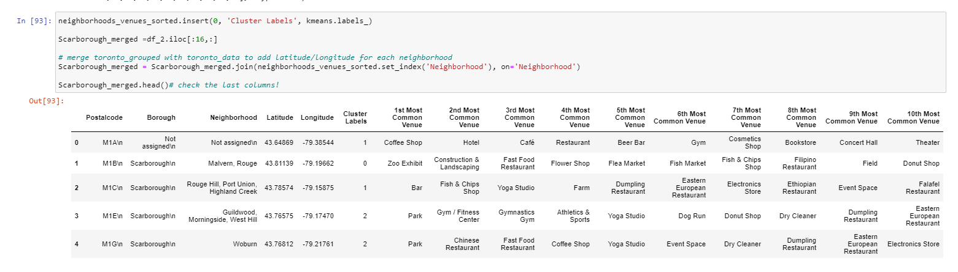
3. Methodology Section
Using K-Means Clustering Approach | Most Common Venue

Slide 8
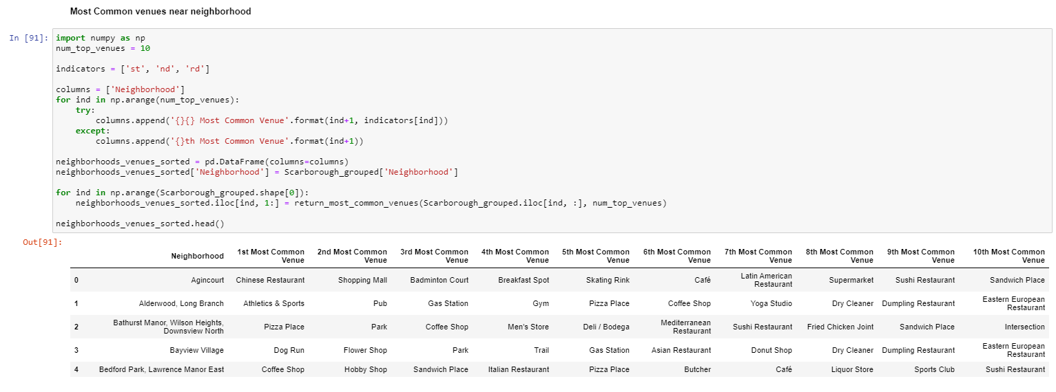
3. Methodology Section
Most Common Venues near Neighborhood | Using Clustering

Slide 9
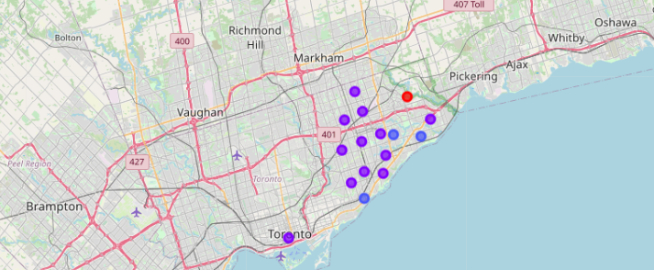
4. Results Section
Map of Clusters in Scarborough

Slide 10
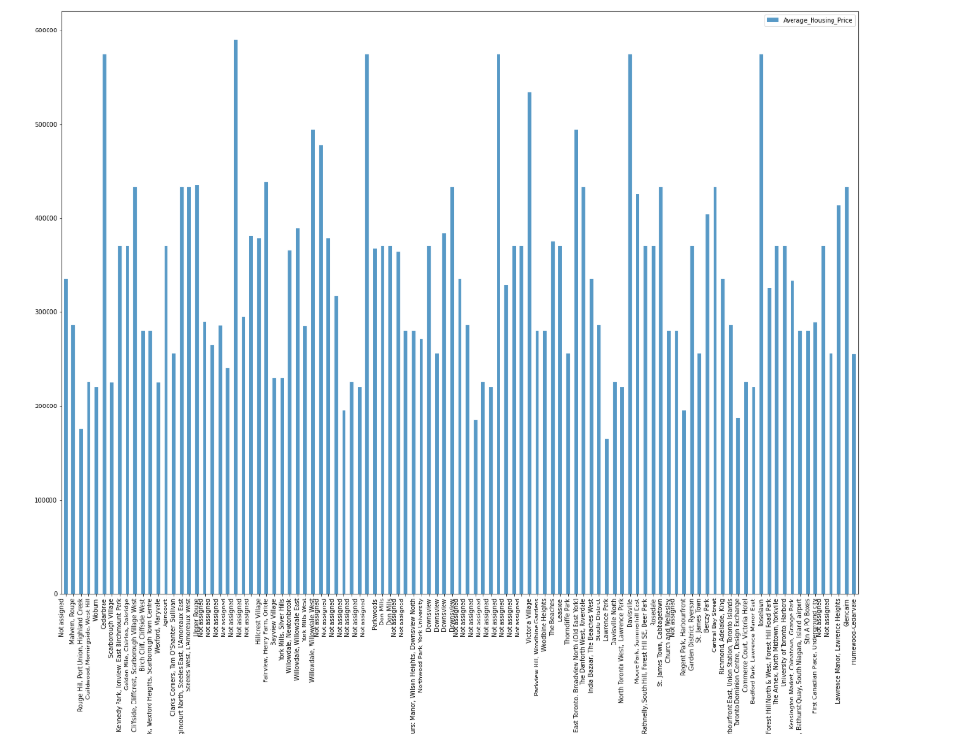
Average Housing Price by Clusters in Scarborough

Slide 11
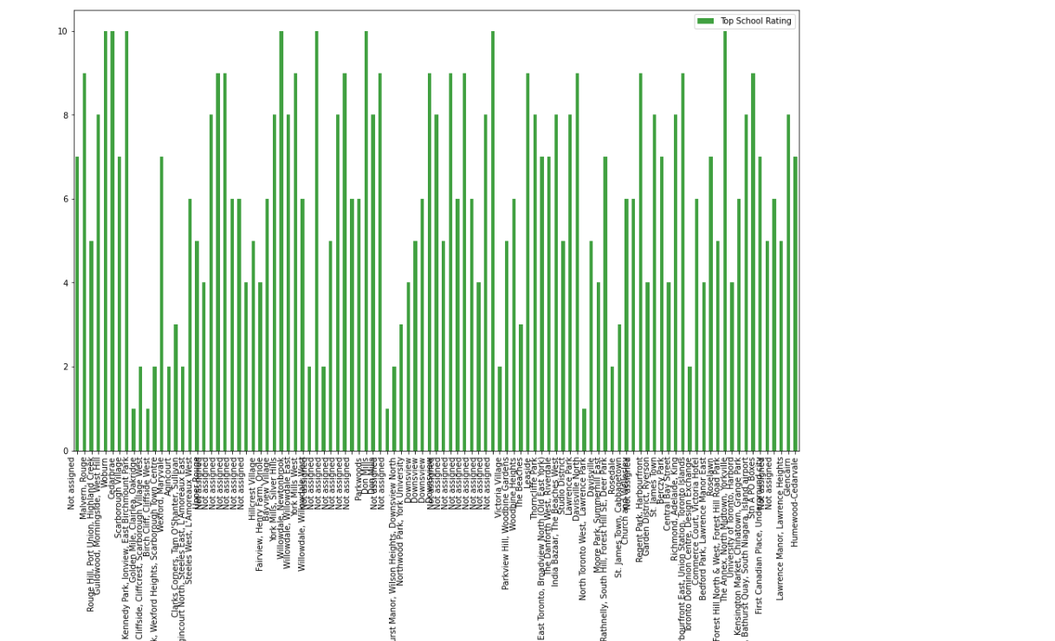
School Ratings by Clusters in Scarborough

Slide 12
5. Discussion Section
The major purpose of this project, is to suggest a better neighborhood in a new city for the person who are shiffting there. Social presence in society in terms of like minded people. Connectivity to the airport, bus stand, city center, markets and other daily needs things nearby.
Sorted list of house in terms of housing prices in a ascending or descending order
Sorted list of schools in terms of location, fees, rating and reviews

Slide 13
6. Conclusion Section
In this Capstone project, using k-means cluster algorithm I separated the neighborhood into 10(Ten) different clusters and for 103 different latitude and logitude from dataset, which have very-similar neighborhoods around them. Using the charts above results presented to a particular neighborhood based on average house prices and school rating have been made.

